Slide 1
Centers of Excellence – Phase 2
USDA
Neil Richmond/Greg Gordon
Opportunity ID: Various
Date
Milestone 1A – Deal Qualification
Milestone 1B – Deal Strategy
Milestone 1C – Deal Strategy Update
DR1
DR2 (Except when TCV> $75)
Tiers 1 & 2

Slide 2
The Centers of Excellence (CoE) teams will provide expert advice, consulting, development and support solution implementation in the following areas:
 | Centers of Excellence | Unisys SFDC
Cloud Adoption | Perform application/system portfolio analysis, develop cloud migration recommendations, plan and manage the migration execution, as well as capture specific capabilities (e.g. strategies, roadmaps, playbooks) to document good practices across government. The goal is to assist agencies accelerate cloud adoption. | SFDC-236260 Cloud Adoption & Infrastructure Optimization may be combined
IT Infrastructure Optimization | Assist agencies with the assessment, development and implementation of computing infrastructure (i.e. network, storage, data center) optimization plans. | SFDC-236261
Customer Experience | Assist agencies with the development and implementation of an optimal client experience strategy. Implementation will include utilization of the latest technology (artificial intelligence, learning systems, and robotic process automation) as well as a cohesive client experience across all channels including contact centers, online platforms, informational materials, and in-person interactions. | SFDC-236289
Service Delivery Analytics | Provide the expertise and tools to define, instrument and analyze ultimate program outcomes, customer experiences and operational effectiveness. Aim to ensure programs and services are designed and delivered in a way that optimizes impact while building trust and confidence in the public. Implementation includes a continuous improvement feedback cycle built into services delivered. | SFDC-236264
Contact Center | Provide a suite of offerings to help agencies manage and enhance their customer contacts where they need assistance the most, be it with managing their contact center operations; building self-service tools; leveraging robotic process automation and emerging technologies; building internal business processes and systems to manage day-to-day performance; navigating available acquisition solutions; and learning contact center best practices. | SFDC-236264

Slide 3
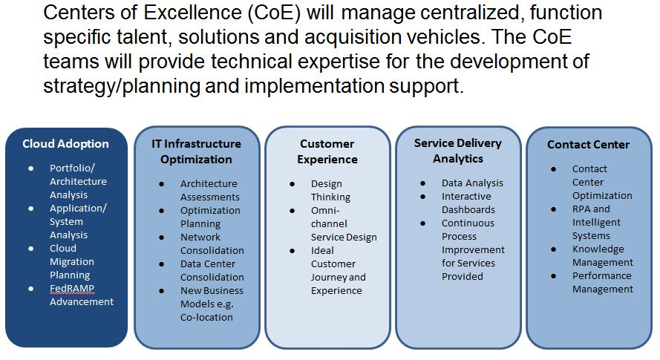
GSA – Centers of Excellence
Phase 1 Provides Discovery, Analysis and Roadmap. The Phase 1 Awardees:
Cloud adoption: SIE Consulting of Arlington, Virginia
IT Infrastructure Optimization: McKinsey & Company in Washington, D.C.
Customer Experience: ICF Inc. of Fairfax, Virginia
Service Delivery Analytics: ICF Inc.
Contact Center: Kaiser Associates Inc. of Washington, D.C.

Slide 4
CoE Led by Dep Sec / OCIO

Slide 5
USDA CoE
Reverse Industry Day Sessions

Slide 6
GSA Announcement
IT Modernization Centers of Excellence Industry Day Announcement
The General Services Administration (GSA) Federal Acquisition Service (FAS) and United States Department of Agriculture (USDA) will host an Industry Day on June 27, 2018 and Reverse Industry Days on June 28 and 29, 2018 for Phase II of the Centers of Excellence (CoE). Phase II will involve implementing recommendations generated during Phase I. Links to register and questions/answers are available on our repository (https://github.com/GSA/coe-industry-day/). If you are unable to attend or we hit capacity, we will be livestreaming (https://www.youtube.com/watch?v=uqGwaEaVlHI) the event.
At the Industry Day, the CoEs will present the number and scope of procurements, communicate the acquisition strategy, and update industry on the progress of USDA as the first CoE customer. Our goal for this event is to address questions and solicit feedback from our industry partners before we release solicitations.
GSA will also be hosting Reverse Industry Days on the 28th and 29th, consisting of one-on-one sessions with industry partners to review the capabilities they can offer to the groups they’re meeting with. GSA will subsequently advertise several orders under Alliant, the Professional Services Schedule, Schedule 70, and other GSA vehicles to address USDA’s needs.
Please review our repository (https://github.com/GSA/coe-industry-day/) to find out what we expect from these events.
Let us know if you have any questions or comments (https://github.com/GSA/coe-industry-day/issues).
--
Al Muñoz
Contracting Officer
GSA Federal Acquisition Service
National Capital Region
Special Projects
alberto.munoz@gsa.gov
Tel: 202-734-4226

Slide 7
Preparing for Reverse Industry Day
At USDA CoE Industry Day, USDA and GSA will discuss the number and scope of anticipated procurements, the proposed acquisition strategies, and provide updates on CoE progress.
At Reverse Industry Days, industry partners should provide a one-page fact sheet on the capabilities to provide a solution for the specific procurement/group you're meeting with. The fact sheet can address previous experience that is directly related to that procurement/group, and recommend ways to improve what we ask for in the solicitation we end up posting – USDA not looking for any marketing information.

Slide 8
Phase 2 Procurement: Data and Analytics Capacity Building and/or Data Visualization and Analytics
Thursday, June 28, 1.30pm (Greg Gordon and Danielle Reinhart)
Data and Analytics Capacity Building
Objective: The objective of this procurement is to develop and enhance USDA data and analytics communities of practice.
Scope: The contractor will work with the Service Delivery Analytics CoE and the USDA OCIO to develop an overall enterprise data strategy, including organizational as well as technical strategies. The contractor will develop a solution for a robust data inventory that is integrated with USDA processes for developing systems. The contractor will also help to develop best practices in data and analytics.
Data Visualization and Analytics
Objective: The objective of this procurement is to develop and implement data analytics and data visualization solutions across USDA that meet the various needs of mission areas and agencies while providing enterprise level capabilities.
Scope: The contractor shall provide technical and organizational expertise to support USDA’s goal of being data-driven. The contractor shall work to overcome challenges around advanced analytics including developing key performance indicators (KPIs), developing and implementing data collection solutions to improve performance measurement, and identifying predictive analytics opportunities and building predictive models.

Slide 9
Phase 2 Procurement: Customer Experience Collaboration Solution
Friday, June 29, 2.30pm (Greg Gordon, Peter ODonoghue)
Objective: The objective of this procurement is to identify a vendor that will be responsible for the acquisition and agile implementation of a web collaboration tool/solution that will meet the broad needs of USDA with the goal of improving real-time communications with field staff across the country.
Scope: The collaboration tool/solution is intended improve/facilitate communications between headquarters and field staff that operate across the country. The tool may also be used to facilitate communications between staff who may want to connect with other colleagues across the country who may have similar duties or who have similar interests, issues, solutions that support their line of work.

Slide 10
Phase 2 Procurement: Contact Center
Friday, June 29, 3.30pm (Greg Gordon, Gary Wang)
Objective: Through this acquisition of products and services, USDA expects to create a single contact center to serve as the front door for phone, email, chat, etc. to:
Put USDA on par with customer experience in the commercial sector
Improve operational flexibility by creating an environment that can efficiently and effectively integrate new capabilities and features
Scope: The Contractor will create a 1-866 ASK USDA omni-channel contact center that will serve as the OneUSDA front door to all USDA information and services. The OneUSDA Contact Center will handle all Tier 0 and Tier 1 contacts via phone, email, chat or other channels with the capability to migrate Tier 2 contacts over time.

Slide 11
Phase 2 Procurement: IT Infrastructure and Cloud Adoption
Friday, June 29, 4pm (Greg Gordon, Peter Odonoghue)
Objective: The objective of this procurement is to provide the expertise to the USDA to modernize and replatform applications onto commercial cloud services. This will be accomplished by leveraging modern innovative information technology throughout the IT investment portfolio, leveraging commercial cloud services to deliver greater flexibility and functionality in support of Agency mission requirements.
Scope: The contractor shall provide professional services to assist GSA/USDA in (1) the staffing and training of a sustainable cloud computing organization within USDA, (2) the closure of identified USDA data centers, and (3) the migration of applications to commercial cloud environments and/or to the remaining two USDA on-premise data centers.

